Slide 1
GENE NETWORK MODELLING
Improved Gene Co-Expression Network Clustering

Slide 2
BACKGROUND

Slide 3
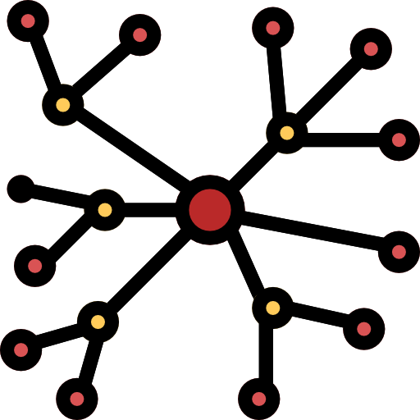
Genes as a Network
Genes do not work alone. They are interconnected as a network.

Slide 4
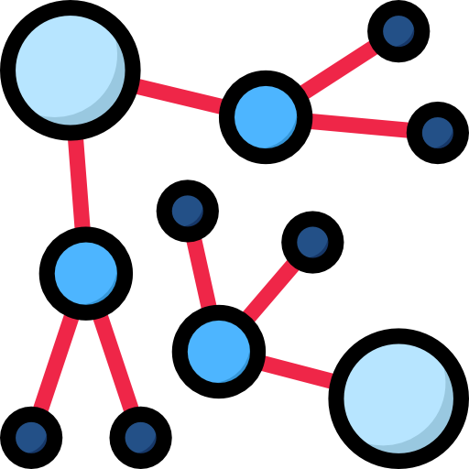

Genes as a Network
Oftentimes, it takes more than one gene to be expressed for a phenotype (e.g. physical trait, disease) to be manifested.

Slide 5
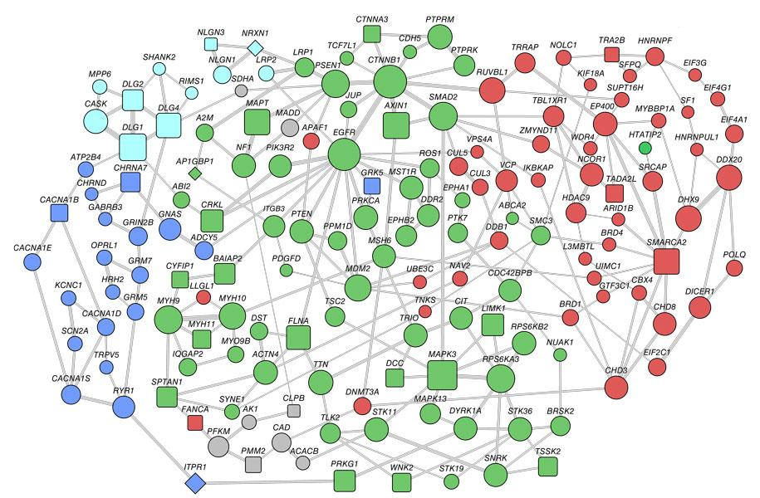
Genes as a Network
Notes:
This is an example of a gene network. So how are gene networks such as this one constructed?

Slide 6
Weighted Gene Co-Expression Network (WGCNA)
WGCNA is a widely used tool to construct and analyze gene co-expression networks, that can be utilized for finding clusters (modules) of highly correlated genes (i.e. hub genes / highly connected network genes).
Correlation networks facilitate network based gene screening methods that can be used to identify candidate biomarkers or therapeutic targets.
Langfelder, P., Horvath, S. (2008). WGCNA: an R package for weighted correlation network analysis. https://bmcbioinformatics.biomedcentral.com/articles/10.1186/1471-2105-9-559

Slide 7
THEORETICAL FRAMEWORK

Slide 8
Gene Co-Expression Network (GCN)
A Gene Co-Expression Network (GCN) is an undirected graph, where each node corresponds to a gene, and each edge connects a pair of genes that are significantly correlated.
Li, J., Zhou, D., Qiu, W., Shi, Y., Yang, J., Chen, S., Wang, Q., & Pan, H. (2018). Application of Weighted Gene Co-expression Network Analysis for Data from Paired Design. https://www.nature.com/articles/s41598-017-18705-z
Notes:
A gene co-expression network is an undirected graph G = (V, E) wherein the vertices (V) correspond to genes, and the edges (E) between the pairs of nodes/vertices are determined by the pairwise Pearson correlations between genes and their expression patterns.

Slide 9
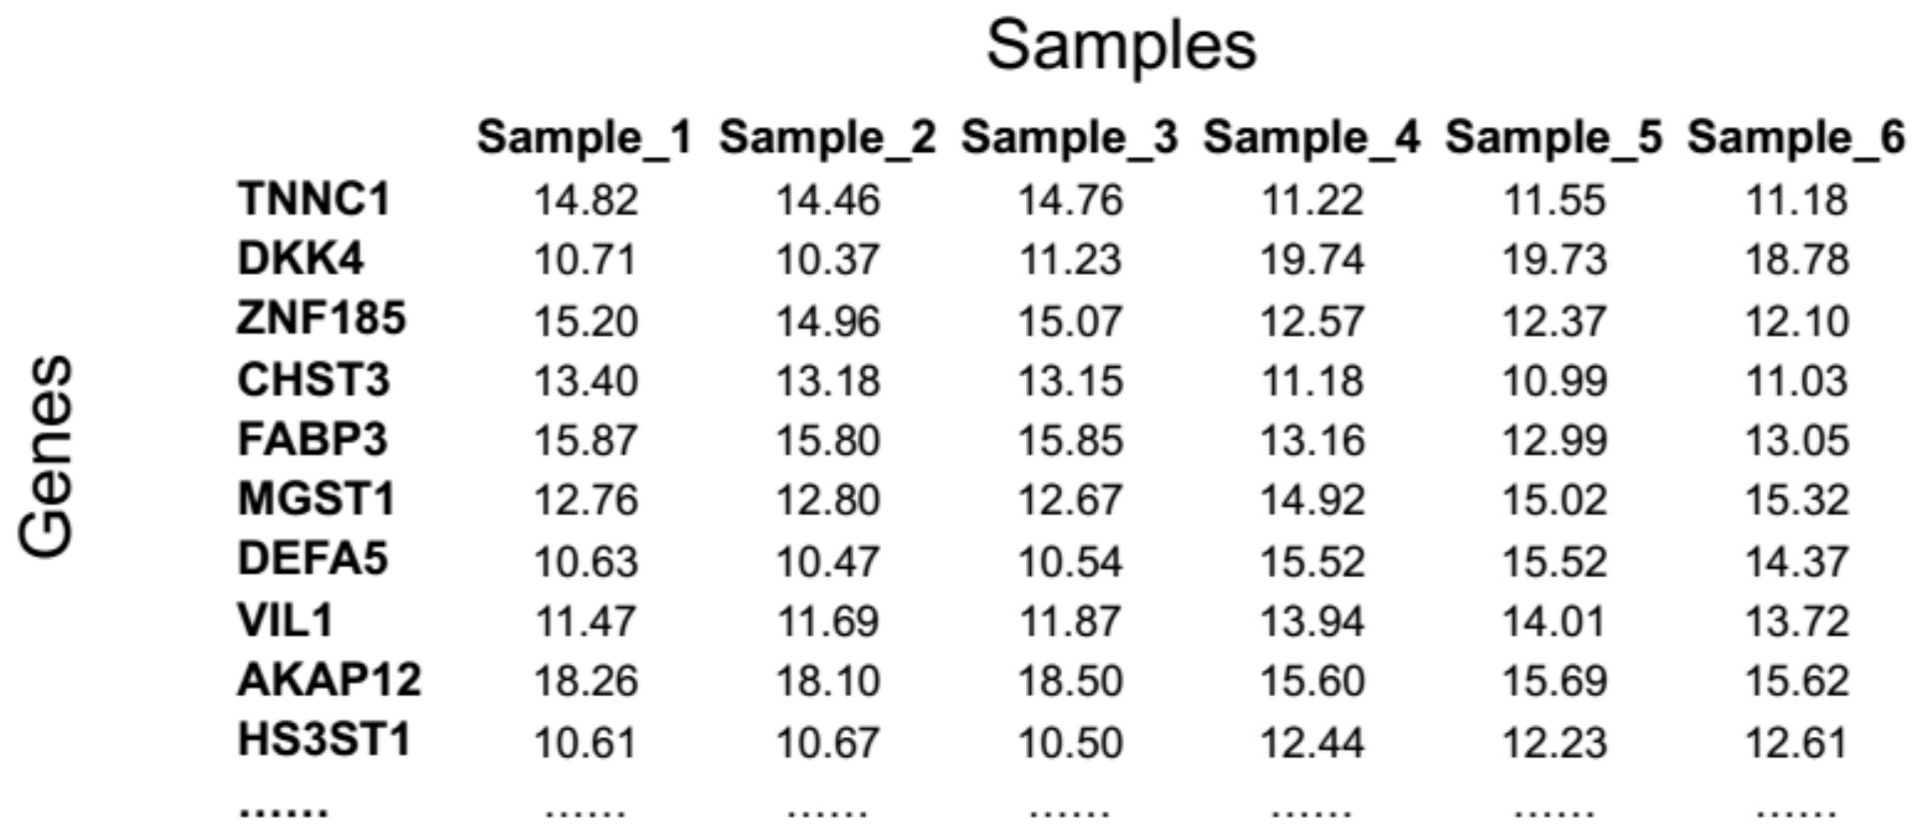
Gene Expression Data
Zhang, B. (2010). Gene Expression Data Analysis (I). http://bioinfo.vanderbilt.edu/zhanglab/lectures/BMIF310_2010_geneExpressionDataAnalysis1.pdf
Notes:
How are gene expression data represented? This is an expression value table / matrix. The rows are genes and the columns are the samples, and their intersection values is the gene expression values of the genes for the samples (conditions).

Slide 10
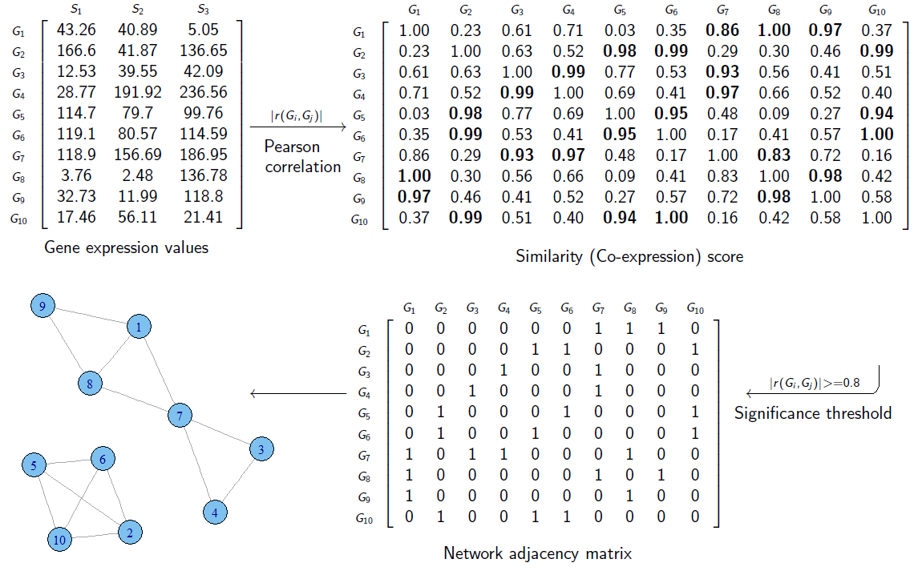
How is a GCN constructed?
S. Mohammad H. Oloomi. The general steps of constructing a gene co-expression network: calculating a co-expression measure, and selecting a significance threshold. (2014).

Slide 11
How is a GCN constructed?
The input data for constructing a gene co-expression network is often represented as a matrix. If we have the gene expression values of m genes for n samples (conditions), the input data would be an m×n matrix, called an expression matrix.
S. Mohammad H. Oloomi. The general steps of constructing a gene co-expression network: calculating a co-expression measure, and selecting a significance threshold. (2014).

Slide 12
How is a GCN constructed?
A similarity score (co-expression measure) is calculated between each pair of rows in expression matrix.
S. Mohammad H. Oloomi. The general steps of constructing a gene co-expression network: calculating a co-expression measure, and selecting a significance threshold. (2014).

Slide 13
How is a GCN constructed?
The resulting matrix is an m×m matrix, called the similarity matrix. Each element in this matrix shows how similarly the expression levels of two genes change together.
S. Mohammad H. Oloomi. The general steps of constructing a gene co-expression network: calculating a co-expression measure, and selecting a significance threshold. (2014).

Slide 14
How is a GCN constructed?
The elements in the similarity matrix which are above a certain threshold (i.e. significance threshold) are replaced by 1s and the remaining elements are replaced by 0s.
S. Mohammad H. Oloomi. The general steps of constructing a gene co-expression network: calculating a co-expression measure, and selecting a significance threshold. (2014).

Slide 15
How is a GCN constructed?
The resulting matrix, called the network adjacency matrix, represents the graph of the constructed gene co-expression network. In this matrix, each element shows whether two genes are connected in the network (the 1 elements) or not (the 0 elements).
S. Mohammad H. Oloomi. The general steps of constructing a gene co-expression network: calculating a co-expression measure, and selecting a significance threshold. (2014).

Slide 16
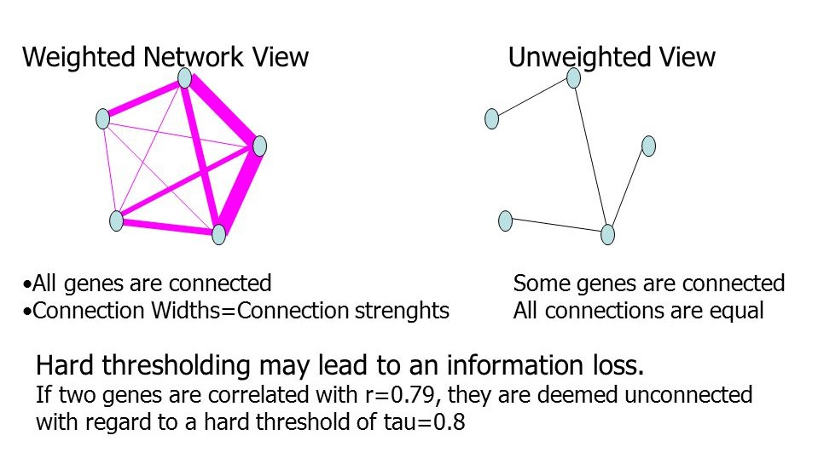
Weighted Networks vs Unweighted Networks
Zhang, B., Horvath, S. A general framework for weighted gene co-expression network analysis. (2005). Statistical Applications in Genetics and Molecular Biology, Volume 4, Issue 1, Article 17.
Notes:
What we constructed earlier is an example of an unweighted gene network. But there is another kind of gene network called weighted gene network.

Slide 17
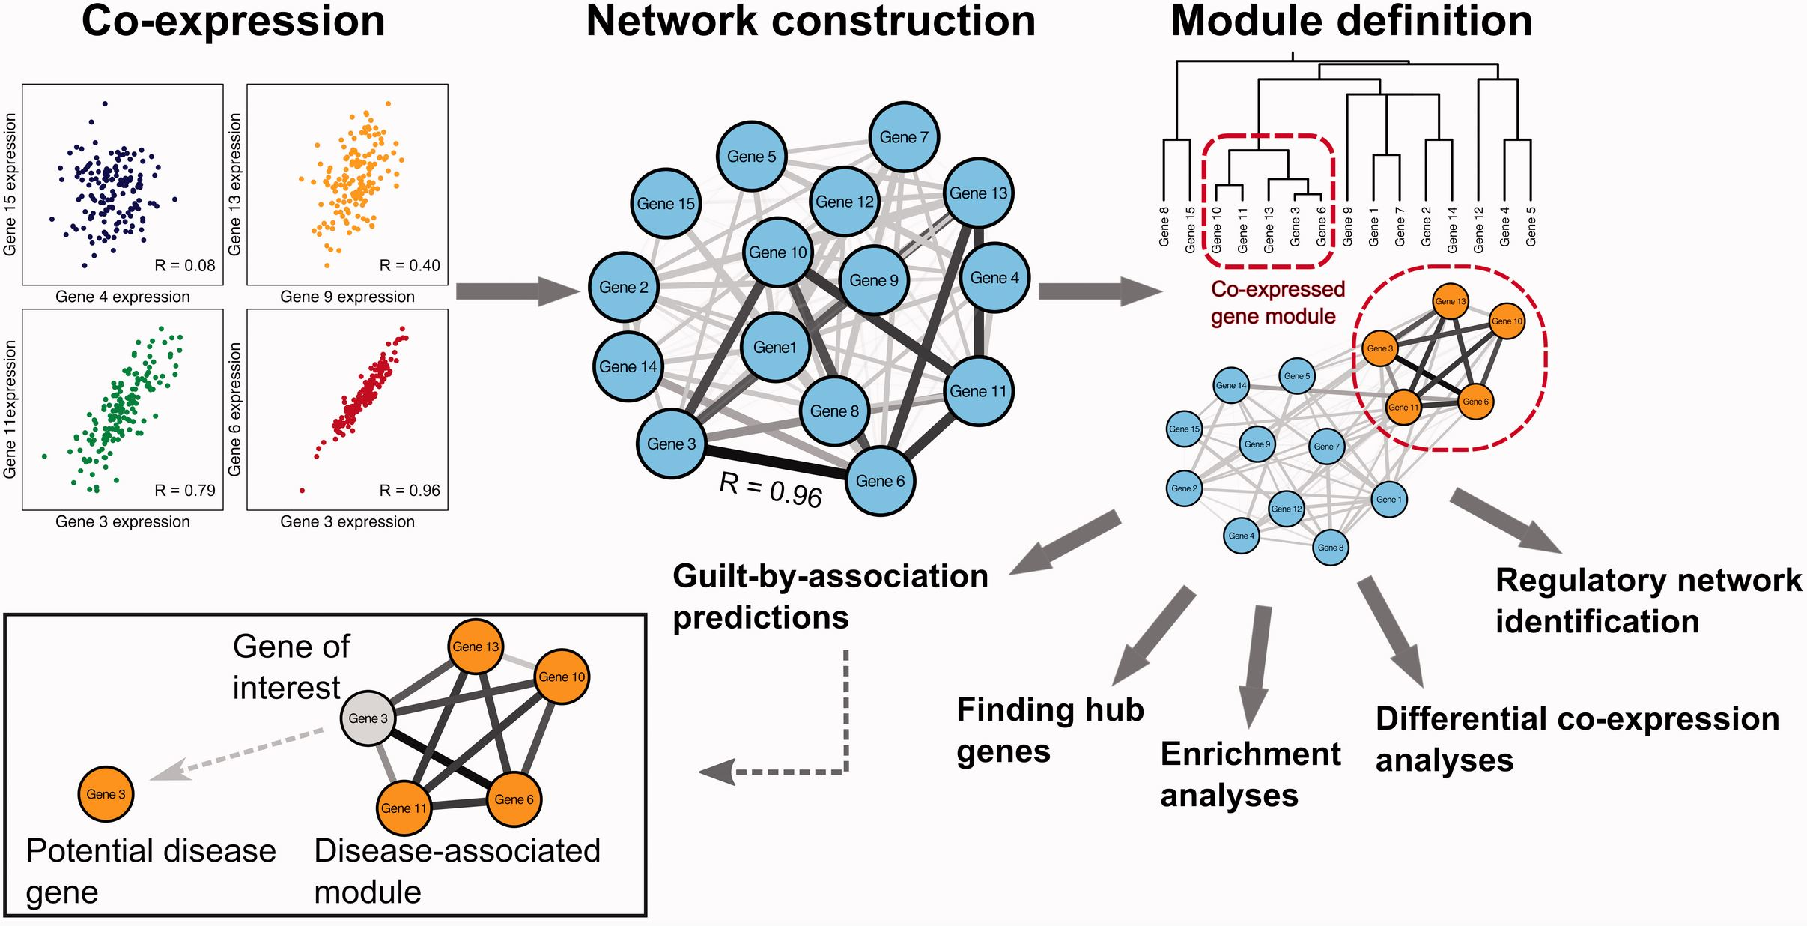
Weighted Gene Co-Expression Network (WGCNA)
van Dam, S., Võsa, U., van der Graaf, A., Franke, L., de Magalhães, J.P. (2018). Gene co-expression analysis for functional classification and gene–disease predictions. https://academic.oup.com/bib/article/19/4/575/2888441

Slide 18
Weighted Gene Co-Expression Network (WGCNA)
Pairwise correlation is determined for each possible gene pair in the expression data.
van Dam, S., Võsa, U., van der Graaf, A., Franke, L., de Magalhães, J.P. (2018). Gene co-expression analysis for functional classification and gene–disease predictions. https://academic.oup.com/bib/article/19/4/575/2888441

Slide 19
Weighted Gene Co-Expression Network (WGCNA)
These pairwise correlations can then be represented as a network.
van Dam, S., Võsa, U., van der Graaf, A., Franke, L., de Magalhães, J.P. (2018). Gene co-expression analysis for functional classification and gene–disease predictions. https://academic.oup.com/bib/article/19/4/575/2888441

Slide 20
Weighted Gene Co-Expression Network (WGCNA)
Modules within these networks are defined using clustering analysis.
van Dam, S., Võsa, U., van der Graaf, A., Franke, L., de Magalhães, J.P. (2018). Gene co-expression analysis for functional classification and gene–disease predictions. https://academic.oup.com/bib/article/19/4/575/2888441

Slide 21
Weighted Gene Co-Expression Network (WGCNA)
The network and modules can be interrogated to identify regulators, functional enrichment and hub genes.
van Dam, S., Võsa, U., van der Graaf, A., Franke, L., de Magalhães, J.P. (2018). Gene co-expression analysis for functional classification and gene–disease predictions. https://academic.oup.com/bib/article/19/4/575/2888441

Slide 22
Weighted Gene Co-Expression Network (WGCNA)
Differential co-expression analysis can be used to identify modules that behave differently under different conditions.
van Dam, S., Võsa, U., van der Graaf, A., Franke, L., de Magalhães, J.P. (2018). Gene co-expression analysis for functional classification and gene–disease predictions. https://academic.oup.com/bib/article/19/4/575/2888441

Slide 23
Weighted Gene Co-Expression Network (WGCNA)
Potential disease genes can be identified using a guilt-by-association (GBA) approach that highlights genes that are co-expressed with multiple disease genes.
van Dam, S., Võsa, U., van der Graaf, A., Franke, L., de Magalhães, J.P. (2018). Gene co-expression analysis for functional classification and gene–disease predictions. https://academic.oup.com/bib/article/19/4/575/2888441

Slide 24
Weighted Gene Co-Expression Network (WGCNA)
This study will focus on improving the clustering mechanism of WGCNA.
van Dam, S., Võsa, U., van der Graaf, A., Franke, L., de Magalhães, J.P. (2018). Gene co-expression analysis for functional classification and gene–disease predictions. https://academic.oup.com/bib/article/19/4/575/2888441

Slide 25
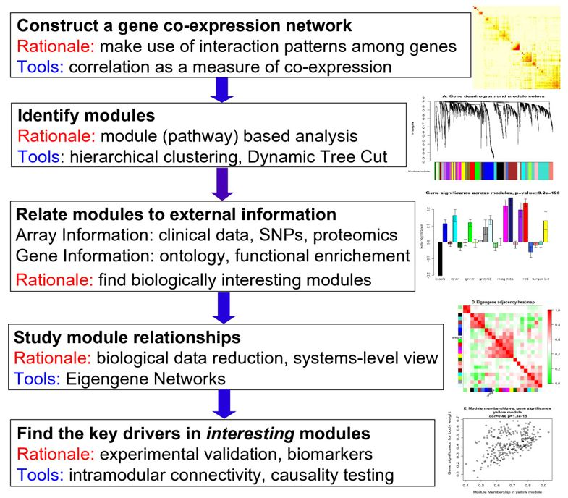
Weighted Gene Co-Expression Network (WGCNA)
Notes:
This is an overview of the of the WGCNA methodology.

Slide 26
Weighted Gene Co-Expression Network (WGCNA)
Notes:
For this study, we will focus on the “Identify modules”

Slide 27
RELATED WORK

Slide 29
PROBLEM STATEMENT

Slide 30
PROBLEM STATEMENT
How to improve the accuracy of WGCNA, particularly its clustering mechanism.
How to assess the difference between the accuracy of of each different variant (HC, HC + k-means hybrid, DBSCAN) of the clustering mechanism of WGCNA.

Slide 31
SIGNIFICANCE OF THE STUDY

Slide 32
SIGNIFICANCE OF THE STUDY
Will open up a better alternative add-on to improve the clustering mechanism of WGCNA, as well as improve gene network modelling as a whole.
Will facilitate improved identification of genes related to the manifestation of deadly diseases such as cancer, which will assist in the prognosis, early detection, and opening up of avenues in finding new cures and treatments against such diseases.

Slide 33
OBJECTIVES

Slide 34
OBJECTIVES
Develop an improvement to the accuracy of the clustering mechanism of WGCNA.
Devise metrics for measuring and comparing the accuracy of the different variants of clustering mechanisms of WGCNA.

Slide 35
SCOPE & LIMITATIONS

Slide 36
SCOPE & LIMITATIONS
Will only be using DNA microarray data.
Will only focus on improving the clustering mechanism of WGCNA.

Slide 37
Hierarchical Clustering

Slide 38
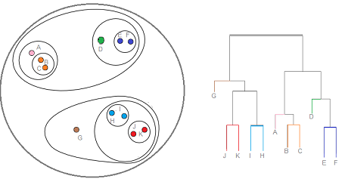
Limitations of Hierarchical Clustering
Hierarchical Clustering
Notes:
a method of cluster analysis which seeks to build a hierarchy of clusters

Slide 39
K-Means Clustering

Slide 40
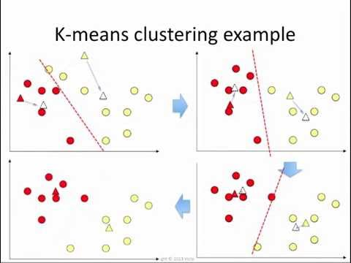
How K-means Clustering improves Hierarchical Clustering
K-Means Clustering
Notes:
k-means clustering aims to partition n observations into k clusters in which each observation belongs to the cluster with the nearest mean, serving as a prototype of the cluster.

Slide 41
DBSCAN
Notes:
It is a density-based clustering non-parametric algorithm: given a set of points in some space, it groups together points that are closely packed together (points with many nearby neighbors), marking as outliers points that lie alone in low-density regions (whose nearest neighbors are too far away). DBSCAN is one of the most common clustering algorithms and also most cited in scientific literature

Slide 42
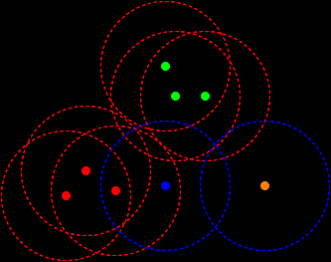
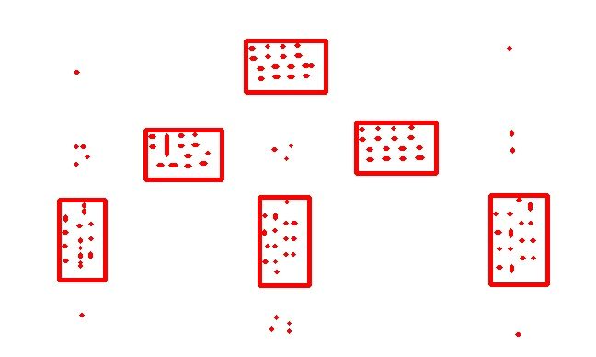
Poss
DBSCAN
Notes:
It is a density-based clustering non-parametric algorithm: given a set of points in some space, it groups together points that are closely packed together (points with many nearby neighbors), marking as outliers points that lie alone in low-density regions (whose nearest neighbors are too far away). DBSCAN is one of the most common clustering algorithms and also most cited in scientific literature

Slide 43
METHODOLOGY

Slide 44
METHODOLOGY
Data
Preprocessing
Similarity Matrix
Construction
Clustering
Testing

Slide 45
METHODOLOGY
Data
Preprocessing
Similarity Matrix
Construction
Clustering
Testing

Slide 46

Data Preprocessing
Data source: Yeast Cell Cycle Analysis Project
The yeast cell cycle analysis project's goal is to identify all genes whose mRNA levels are regulated by the cell cycle. This site complements the published information from:
Spellman et al., (1998). Comprehensive Identification of Cell Cycle-regulated Genes of the Yeast Saccharomyces cerevisiae by Microarray Hybridization. Molecular Biology of the Cell 9, 3273-3297.
http://genome-www.stanford.edu/cellcycle/

Slide 47
Data Preprocessing
Rows = genes (6178 + 1 (column labels))
Columns = samples (82 + 1 (row labels))
 | V1 | V2 | V3 | V4 | V5
1 |  | cln3-1 | cln3-2 | clb | clb2-2
2 | YAL001C | 0.15 | NA | NA | -0.22
3 | YAL002W | -0.07 | -0.76 | NA | -0.12
4 | YAL003W | -1.22 | -0.27 | NA | -0.1
5 | YAL004W | -0.09 | 1.2 | NA | 0.24
http://genome-www.stanford.edu/cellcycle/data/rawdata/combined.txt
Notes:
This is a snapshot of the downloaded yeast data
It has 6179 rows and 83 columns
The rows correspond to the genes while the columns correspond to the samples
We removed unnecessary columns
Take note that we need an input wherein the rows are the samples and the columns are the genes
We transpose the data and properly name the rows and columns

Slide 48
Data Preprocessing
Rows = samples (77)
Columns = genes (6178)
 | YAL001C | YAL002W | YAL003W | YAL004W
cln3-1 | 0.15 | -0.07 | -1.22 | -0.09
cln3-2 | NA | -0.76 | -0.27 | 1.20
clb2-2 | -0.22 | -0.12 | -0.10 | 0.16
clb2-1 | 0.07 | -0.25 | 0.23 | -0.14
alpha0 | -0.15 | -0.11 | -0.14 | -0.02
Notes:
This is a snapshot of the result
We can see that some values are missing

Slide 49
Data Preprocessing
Rows = samples (77)
Columns = genes (6178)
 | YAL001C | YAL002W | YAL003W | YAL004W
cln3-1 | 0.15 | -0.07 | -1.22 | -0.09
cln3-2 | -0.0004 | -0.76 | -0.27 | 1.20
clb2-2 | -0.22 | -0.12 | -0.10 | 0.16
clb2-1 | 0.07 | -0.25 | 0.23 | -0.14
alpha0 | -0.15 | -0.11 | -0.14 | -0.02
Notes:
We filled up missing values using mean imputation, which is computed by getting the average value of the existing values in a column, and using that value to fill up the missing values in that particular column

Slide 50
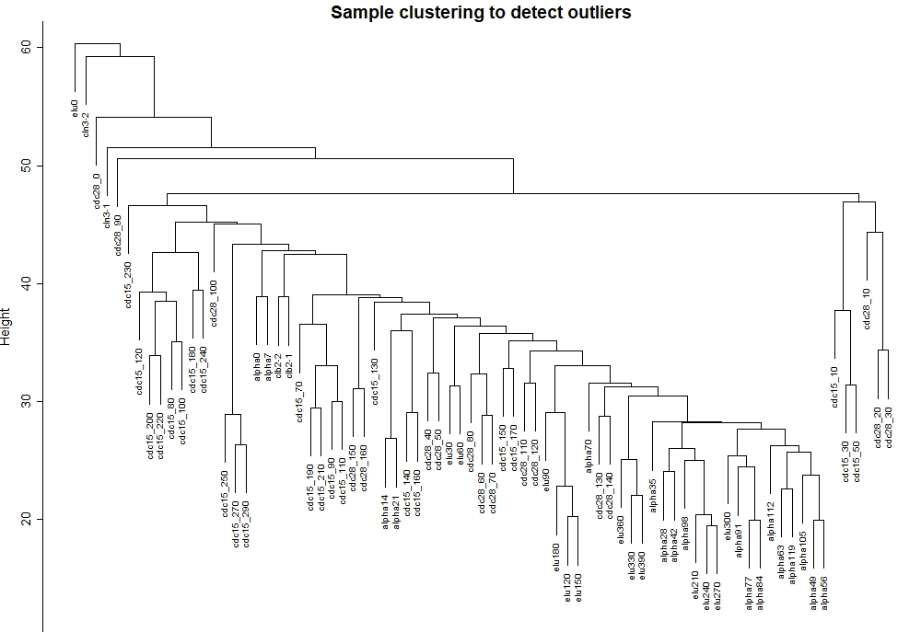
Data Preprocessing
Notes:
Cluster the samples (in contrast to clustering genes that will come later) to see if there are any obvious outliers

Slide 51
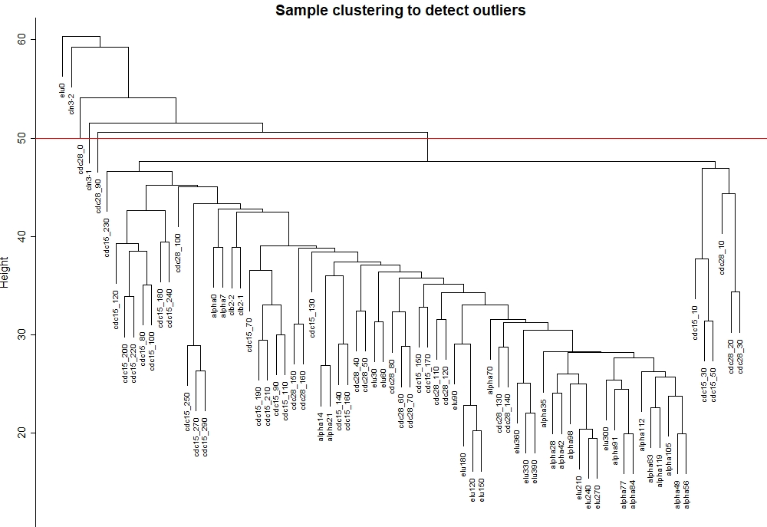
Data Preprocessing
Notes:
Cluster the samples (in contrast to clustering genes that will come later) to see if there are any obvious outliers

Slide 52
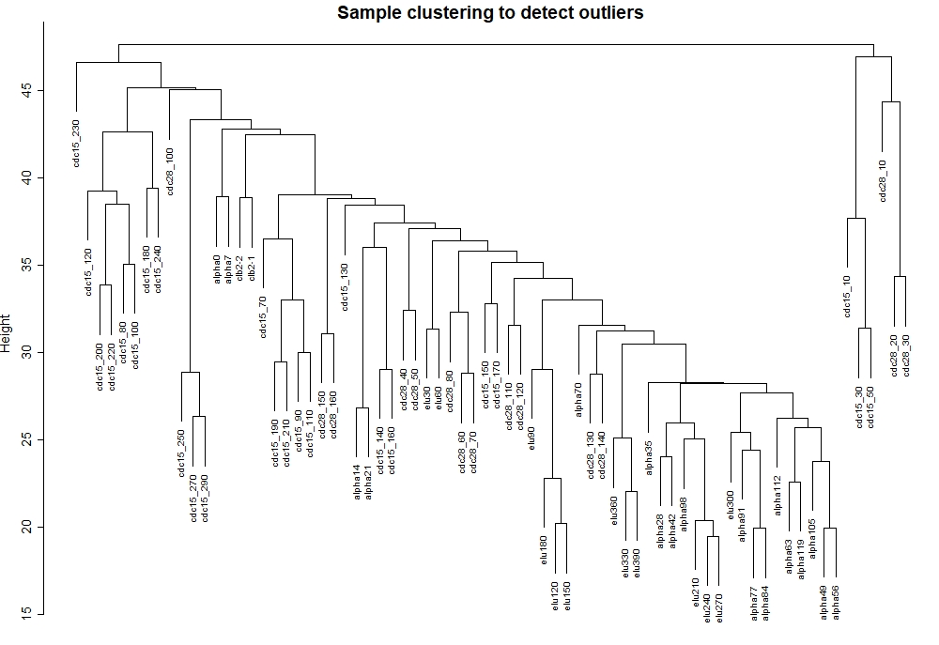
Data Preprocessing
Notes:
Cluster the samples (in contrast to clustering genes that will come later) to see if there are any obvious outliers

Slide 53
Data Preprocessing
Rows = samples (72)
Columns = genes (6178)
Total number of data frame cells: 444,816
 | YAL001C | YAL002W | YAL003W | YAL004W
clb2-2 | -0.22 | -0.12 | -0.10 | 0.16
clb2-1 | 0.07 | -0.25 | 0.23 | -0.14
alpha0 | -0.15 | -0.11 | -0.14 | -0.02
alpha7 | -0.15 | 0.1 | -0.71 | -0.48
alpha14 | -0.21 | 0.01 | 0.1 | -0.11
Notes:
We have removed 5 sample outliers from the data

Slide 54
METHODOLOGY
Data
Preprocessing
Similarity Matrix
Construction
Clustering
Testing

Slide 55
Similarity Matrix Construction
Adjacency
Matrix
Topological
Overlap
Matrix
Distance
Matrix
(1 - TOM)

Slide 56
Similarity Matrix Construction
Adjacency
Matrix
Topological
Overlap
Matrix
Distance
Matrix
(1 - TOM)

Slide 57
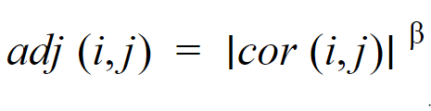
Adjacency Matrix
i and j are genes
ß is the soft thresholding parameter
Notes:
The β parameter is an integer that modulates how smooth is the transition between the lowest to the highest possible co-regulation between genes.

Slide 58
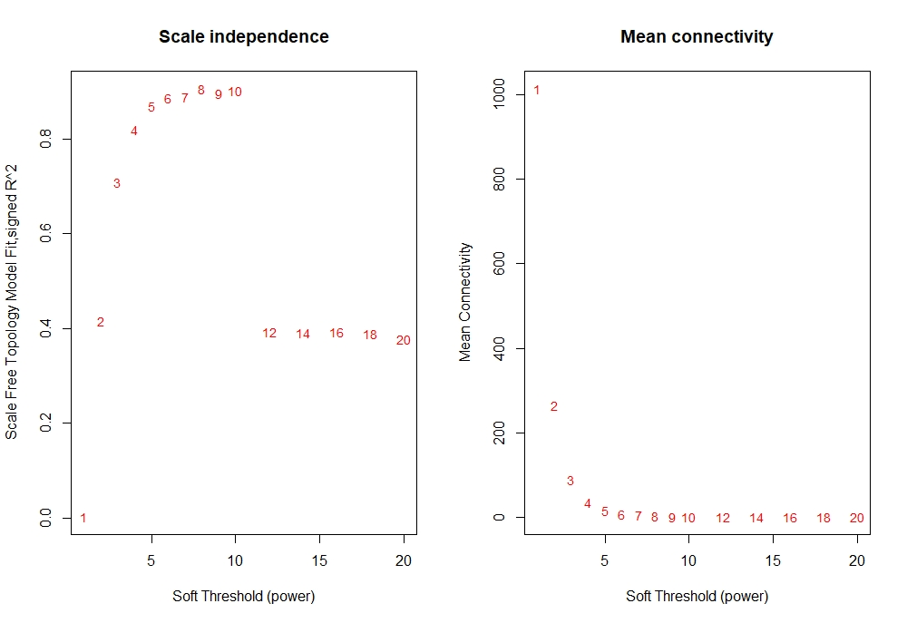
Adjacency Matrix
Notes:
We choose the power 5, which is the lowest power for which the scale-free topology fit index curve flattens out upon reaching a high value (in this case, roughly 0.90).

Slide 59
Adjacency Matrix
 | YAL001C | YAL002W | YAL003W
YAL001C | 1.000000e+00 | 7.724569e-03 | 1.115093e-05
YAL002W | 7.724569e-03 | 1.000000e+00 | 9.744732e-05
YAL003W | 1.115093e-05 | 9.744732e-05 | 1.000000e+00

Slide 60
Similarity Matrix Construction
Adjacency
Matrix
Topological
Overlap
Matrix
Distance
Matrix
(1 - TOM)

Slide 61
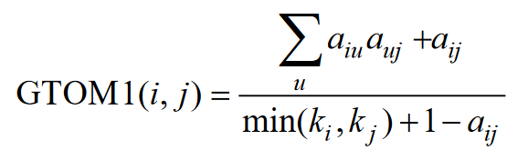

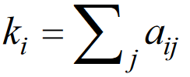
Topological Overlap Matrix
= adjacency between genes
= number of direct neighbors

Slide 62
Topological Overlap Matrix
 | V1 | V2 | V3
1 | 1.0000000000 | 0.0066691360 | 0.0003744724
2 | 0.0066691360 | 1.0000000000 | 0.0008440548
3 | 0.0003744724 | 0.0008440548 | 1.0000000000

Slide 63
Similarity Matrix Construction
Adjacency
Matrix
Topological
Overlap
Matrix
Dissimilarity
Matrix
(1 - TOM)

Slide 64
Distance Matrix (1 - TOM)
 | V1 | V2 | V3
1 | 0.0000000 | 0.9933309 | 0.9996255
2 | 0.9933309 | 0.0000000 | 0.9996255
3 | 0.9996255 | 0.9991559 | 0.0000000

Slide 65
Similarity Matrix Construction
Adjacency
Matrix
Topological
Overlap
Matrix
Distane
Matrix
(1 - TOM)

Slide 66
METHODOLOGY
Data
Preprocessing
Similarity Matrix
Construction
Clustering
Testing

Slide 67
Clustering
Hierarchical
Clustering
Additional
Kmeans
Clustering
DBSCAN

Slide 68
Clustering
Hierarchical
Clustering
Additional
Kmeans
Clustering
DBSCAN

Slide 69
Hierarchical Clustering
 | A | B | C | D
A | 0 | 0.5 | 0.8 | 0.6
B | 0.5 | 0 | 0.2 | 0.7
C | 0.8 | 0.2 | 0 | 0.4
D | 0.6 | 0.7 | 0.4 | 0

Slide 70
Hierarchical Clustering
 | A | B | C | D
A | 0 | 0.5 | 0.8 | 0.6
B | 0.5 | 0 | 0.2 | 0.7
C | 0.8 | 0.2 | 0 | 0.4
D | 0.6 | 0.7 | 0.4 | 0

Slide 71
Hierarchical Clustering
 | A | B | C | D
A | 0 | 0.5 | 0.8 | 0.6
B | 0.5 | 0 | 0.2 | 0.7
C | 0.8 | 0.2 | 0 | 0.4
D | 0.6 | 0.7 | 0.4 | 0

Slide 72
Hierarchical Clustering
 | A | B | C | D
A | 0 | 0.5 | 0.8 | 0.6
B | 0.5 | 0 | 0.2 | 0.7
C | 0.8 | 0.2 | 0 | 0.4
D | 0.6 | 0.7 | 0.4 | 0

Slide 73
Hierarchical Clustering
 | A | (B , C) | D
A | 0 | 0.8 | 0.6
(B , C) | 0.8 | 0 | 0.7
D | 0.6 | 0.7 | 0

Slide 74
Hierarchical Clustering
1.0
0.8
0.6
0.4
0.2
B
C

Slide 75
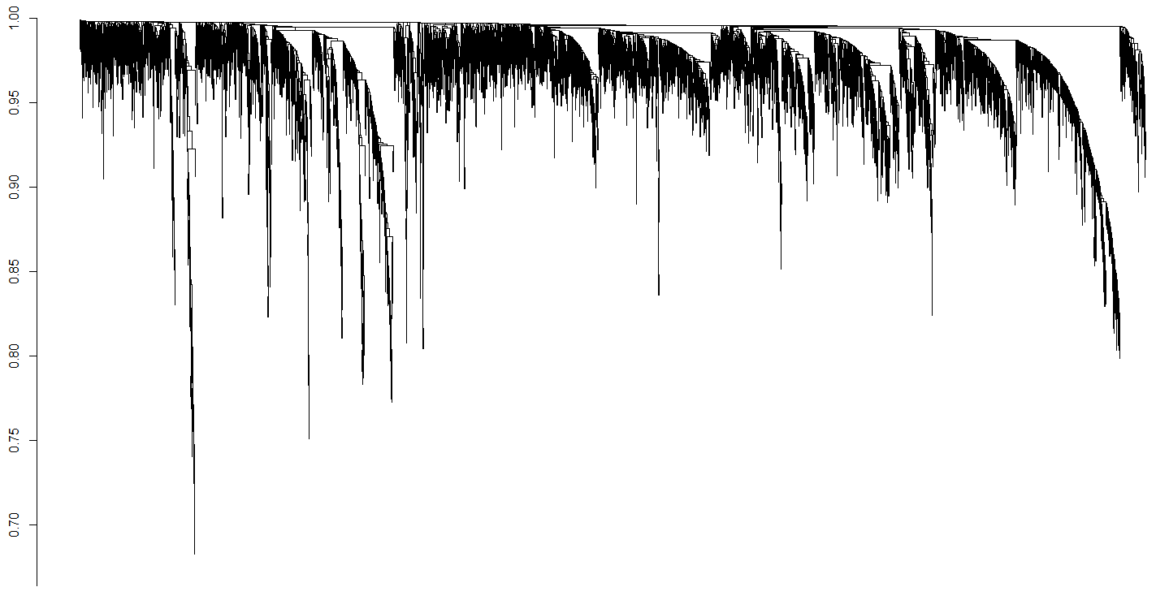
Hierarchical Clustering
1.0
0.8
0.6
0.4
0.2
B
C

Slide 76
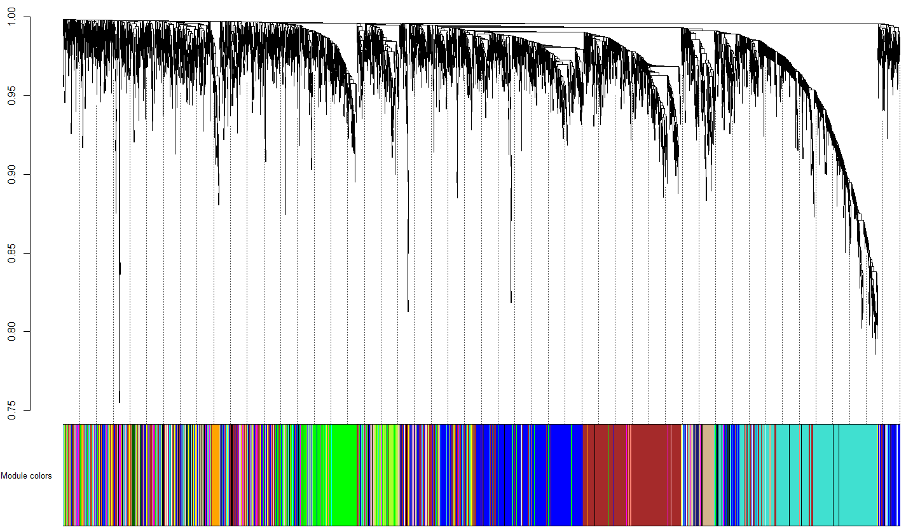
Hierarchical Clustering
1.0
0.8
0.6
0.4
0.2
B
C

Slide 77
Hierarchical Clustering
0 | 1 | 2 | 3 | 4 | 5 | 6 | 7 | 8 | 9
658 | 935 | 812 | 730 | 337 | 330 | 255 | 217 | 216 | 182
10 | 11 | 12 | 13 | 14 | 15 | 16 | 17 | 18 | 19
179 | 173 | 164 | 144 | 115 | 103 | 94 | 69 | 69 | 67
20 | 21 | 22 | 23 | 24 | 25 | 26 | 27
54 | 49 | 49 | 44 | 37 | 33 | 32 | 31

Slide 78
Hierarchical Clustering
0 | 1 | 2 | 3 | 4 | 5 | 6 | 7 | 8 | 9 | 10 | 11
751 | 929 | 871 | 801 | 408 | 383 | 354 | 163 | 161 | 153 | 152 | 132
12 | 13 | 14 | 15 | 16 | 17 | 18 | 19 | 20 | 21 | 22
132 | 125 | 107 | 94 | 82 | 80 | 76 | 74 | 59 | 52 | 39

Slide 79
Limitations of Hierarchical Clustering
Limitations of Hierarchical Clustering
Based on the type of distance matrix chosen for merging different algorithms can suffer with one or more of the following:
Sensitivity to noise and outliers
Breaking large clusters
Difficulty handling different sized clusters and convex shapes
Karypis G., Han E. H. and Kumar V. (1999), CHAMELEON: A hierarchical clustering algorithm using dynamic modeling, Computer 32(8): 68-75, 1999.

Slide 80
Limitations of Hierarchical Clustering
Limitations of Hierarchical Clustering
The merging decisions are based upon static modeling of the clusters to be merged.
Once a gene falls under a subdendrogram, this decision cannot be modified.
Karypis G., Han E. H. and Kumar V. (1999), CHAMELEON: A hierarchical clustering algorithm using dynamic modeling, Computer 32(8): 68-75, 1999.

Slide 81
Limitations of Hierarchical Clustering
Hierarchical Clustering Improvements
Additional K-means Clustering
Use Density-based Spatial Clustering of Applications with Noise (DBSCAN)
Karypis G., Han E. H. and Kumar V. (1999), CHAMELEON: A hierarchical clustering algorithm using dynamic modeling, Computer 32(8): 68-75, 1999.

Slide 82
Clustering
Hierarchical
Clustering
Additional
K-means
Clustering
DBSCAN

Slide 83
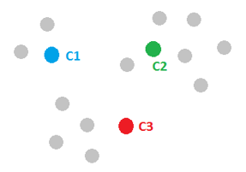
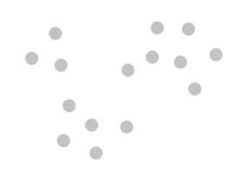
Additional K-means Clustering
Step one: Initialize cluster centers.

Slide 84
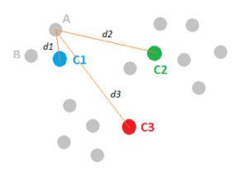
Additional K-means Clustering
Step two: Assign observations to the closest cluster center.
Notes:
Then, all the data points that are the closest (similar) to a centroid will create a cluster.

Slide 85
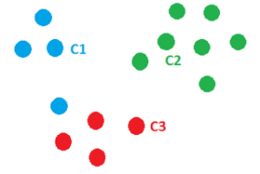
Additional K-means Clustering
Step three: Revise cluster centers as mean of assigned observations.
Notes:
Now, we have new clusters, that need centers. A centroid’s new value is going to be the mean of all the examples in a cluster.

Slide 86
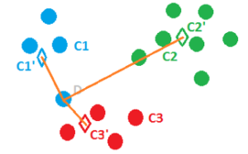
Additional K-means Clustering
Step four: Repeat step 2 and step 3 until convergence.
Notes:
We’ll keep repeating step 2 and 3 until the centroids stop moving, in other words, K-means algorithm is converged.

Slide 87
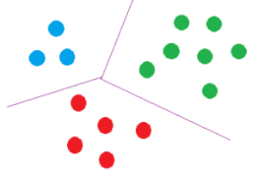
Additional K-means Clustering
Finally, we may get a solution like the following figure.

Slide 88
Additional K-means Clustering
1 | 2 | 3 | 4 | 5 | 6 | 7 | 8 | 9 | 10 | 11
481 | 48 | 1470 | 242 | 89 | 277 | 63 | 276 | 143 | 332 | 255
12 | 13 | 14 | 15 | 16 | 17 | 18 | 19 | 20 | 21 | 22
518 | 341 | 103 | 34 | 706 | 242 | 122 | 45 | 167 | 89 | 135

Slide 89
How K-means Clustering improves Hierarchical Clustering
How K-means Clustering improves Hierarchical Clustering
K-means will move genes between modules thus effectively undoing premature decisions made by HC when assigning genes to sub-dendrograms.
Botía, J. A., Vandrovcova, J., Forabosco, P., Guelfi, S., D'Sa, K. United Kingdom Brain Expression Consortium, Hardy, J., Lewis, CM., Ryten, M., Weale, ME. (2017). An additional k-means clustering step improves the biological features of WGCNA gene co-expression networks. https://bmcsystbiol.biomedcentral.com/articles/10.1186/s12918-017-0420-6

Slide 90
How K-means Clustering improves Hierarchical Clustering
How K-means Clustering improves Hierarchical Clustering
K-means also takes advantage of HC to carry out sensible initialization. The value of k is equal to the number of modules discovered by H.
Botía, J. A., Vandrovcova, J., Forabosco, P., Guelfi, S., D'Sa, K. United Kingdom Brain Expression Consortium, Hardy, J., Lewis, CM., Ryten, M., Weale, ME. (2017). An additional k-means clustering step improves the biological features of WGCNA gene co-expression networks. https://bmcsystbiol.biomedcentral.com/articles/10.1186/s12918-017-0420-6
Notes:
To further improve the clustering of WGCNA we looked for other clustering methods which could be an alternative to hierarchical clustering. As an alternative we look into DBSCAN.

Slide 91
Clustering
Hierarchical
Clustering
Additional
K-means
Clustering
DBSCAN

Slide 92
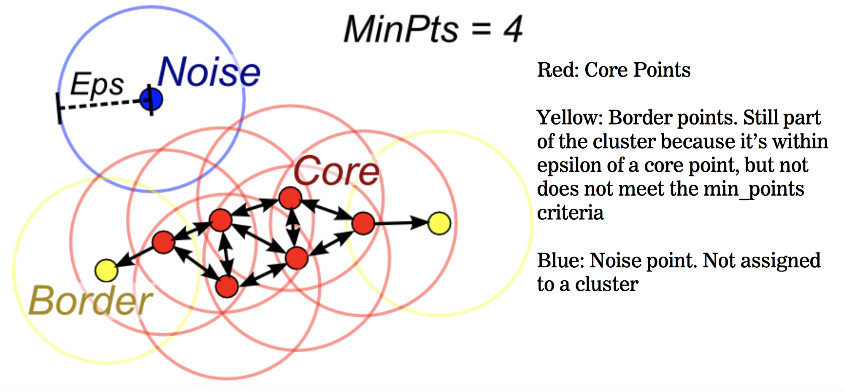
DBSCAN

Slide 93
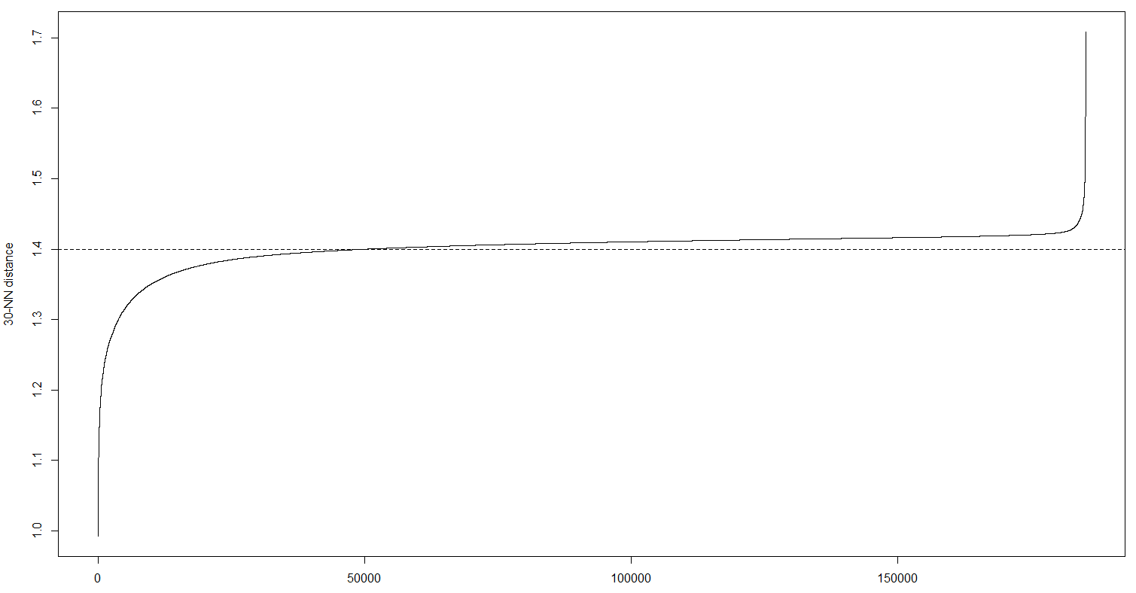
DBSCAN

Slide 94
DBSCAN
0 | 1 | 2 | 3 | 4 | 5 | 6 | 7 | 8 | 9 | 10
4915 | 51 | 233 | 179 | 308 | 127 | 137 | 122 | 44 | 31 | 13
0 | 1 | 2 | 3 | 4 | 5
3628 | 59 | 2369 | 34 | 35 | 53

Slide 95
Poss
How DBSCAN improves Hierarchical Clustering
DBSCAN can find arbitrarily shaped clusters. It can even find a cluster completely surrounded by a different cluster. It also reduces the so called single-link effect.
Ester, M., Kriegel, H-P., Sander, J., and Xu X. (1996), A density-based algorithm for discovering clusters in large spatial data sets with noise. Proc. 2nd Int. Conf. on Knowledge Discovery and Data Mining. Portland, OR, pp. 226–231.

Slide 96
How DBSCAN improves Hierarchical Clustering
DBSCAN has a notion of noise, and is robust to outliers.
Ester, M., Kriegel, H-P., Sander, J., and Xu X. (1996), A density-based algorithm for discovering clusters in large spatial data sets with noise. Proc. 2nd Int. Conf. on Knowledge Discovery and Data Mining. Portland, OR, pp. 226–231.
Notes:
DBSCAN can find arbitrarily shaped clusters. It can even find a cluster completely surrounded by (but not connected to) a different cluster. Due to the MinPts parameter, the so-called single-link effect (different clusters being connected by a thin line of points) is reduced.

Slide 97
How DBSCAN improves Hierarchical Clustering
DBSCAN does not require one to specify the number of clusters in the data a priori, as opposed to k-means.
Ester, M., Kriegel, H-P., Sander, J., and Xu X. (1996), A density-based algorithm for discovering clusters in large spatial data sets with noise. Proc. 2nd Int. Conf. on Knowledge Discovery and Data Mining. Portland, OR, pp. 226–231.
Notes:
DBSCAN can find arbitrarily shaped clusters. It can even find a cluster completely surrounded by (but not connected to) a different cluster. Due to the MinPts parameter, the so-called single-link effect (different clusters being connected by a thin line of points) is reduced.

Slide 98
How DBSCAN improves Hierarchical Clustering
DBSCAN is much faster than hierarchical clustering algorithms and partitioning algorithms (k-means clustering).
Kotsiantis, S.B., Pintelas, P.E. Recent Advances in Clustering: A Brief Survey. http://www.cs.utsa.edu/~bylander/cs6243/kotsiantis-clustering.pdf
Notes:
DBSCAN can find arbitrarily shaped clusters. It can even find a cluster completely surrounded by (but not connected to) a different cluster. Due to the MinPts parameter, the so-called single-link effect (different clusters being connected by a thin line of points) is reduced.

Slide 99
METHODOLOGY
Data
Preprocessing
Similarity Matrix
Construction
Clustering
Testing

Slide 100
Simulation of Expression Data
0 | 1 | 2 | 3 | 4 | 5 | 6 | 7 | 8 | 9 | 10 | 11
751 | 929 | 871 | 801 | 408 | 383 | 354 | 163 | 161 | 153 | 152 | 132
12 | 13 | 14 | 15 | 16 | 17 | 18 | 19 | 20 | 21 | 22
132 | 125 | 107 | 94 | 82 | 80 | 76 | 74 | 59 | 52 | 39

Slide 101
Simulation of Expression Data
 | ME0 | ME1 | ME2 | ME3
clb2-2 | -0.1705226627 | -0.0099377445 | -0.0688636880 | -0.120862657
clb2-1 | -0.0448578285 | 0.0442987832 | -0.0379136071 | 0.081158390
alpha0 | -.0.0109177133 | 0.0186591897 | 0.0476899129 | 0.047305752
alpha7 | 0.0181013678 | 0.0137844366 | -0.2008480669 | -0.05915007
Notes:
This is the snapshot of the module eigengenes, which is one of the outputs of standard WGCNA.

Slide 102
Simulation of Expression Data
 | Gene.1 | Gene.2 | Gene.3 | Gene.4
Sample.1 | 0.164301979 | 0.113591377 | -0.28074029 | -0.093165177
Sample.2 | 0.602936536 | 0.230615349 | -0.14317368 | 0.441914844
Sample.3 | 2.148679247 | 2.333865523 | -2.33391054 | 2.389441181
Sample.4 | -0.175852003 | -0.070637270 | -0.03390106 | -0.295089067
Notes:
This is a snapshot of the produced simulated data.
The size of the simulated data is 72 sample and 6178 genes, which is the same as the original pre processed output

Slide 103
Simulated Data
Simulation of Expression Data
0 | 1 | 2 | 3 | 4 | 5 | 6 | 7 | 8 | 9 | 10 | 11
753 | 928 | 871 | 800 | 408 | 383 | 354 | 163 | 161 | 153 | 152 | 132
12 | 13 | 14 | 15 | 16 | 17 | 18 | 19 | 20 | 21 | 22
132 | 125 | 107 | 94 | 82 | 80 | 76 | 74 | 59 | 52 | 39
Notes:
The data simulation process produces a simulated data, as well as the ideal theoretical module assignments / module partitions

Slide 104

Testing
Given a pair of input vectors which contains information about two different partitionings (let say U and V) of the same data set X.
We refer to a pair of points (we assume that i != j) from the data set using the following terms:

Slide 105
Testing
SS = number of pairs where both points belong to the same cluster in both partitionings U and V.
SD = number of pairs where both points belong to the same cluster in partitioning U but not in V.
DS = number of pairs where both points belong to the same cluster in partitioning V but not in U.
DD = number of pairs where both points belong to different clusters in both partitionings U and V.

Slide 106
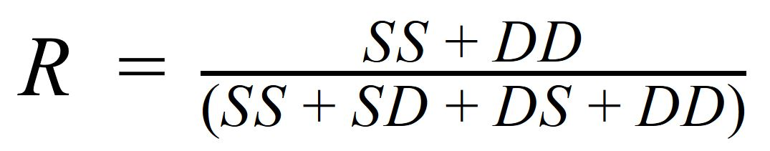
Rand Index
The Rand Index is a measure of the similarity between two data clusterings.
Since the denominator is the total number of pairs, the Rand Index represents the frequency of occurrence of agreements over the total pairs.

Slide 107
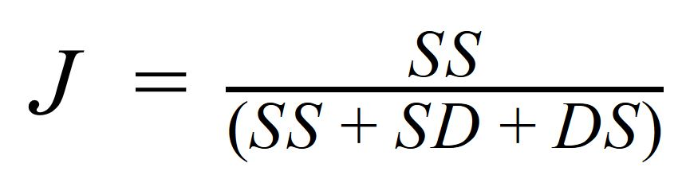
Jaccard Coefficient
The Jaccard Coefficient is used for gauging the similarity and diversity of sample sets.
The Jaccard Coefficient is also known as the Intersection over Union.

Slide 108
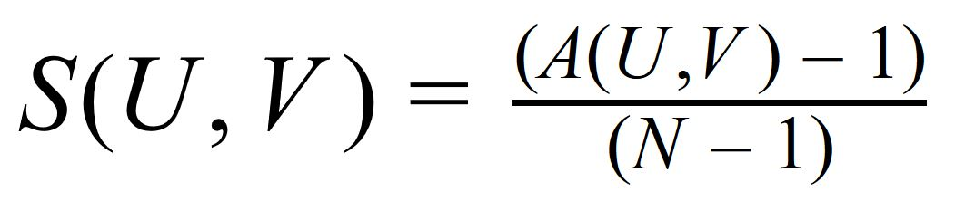
Similarity Index
where N is the number of partitioned objects.
The Similarity Index based on the confusion matrix is the measure which estimates how those two different partitionings, coming from one dataset, are different from each other.

Slide 109


Similarity Index
confusion matrix for partitionings U and V.
Any one to one function sigma is called an assignment or association.
Using a set of assignment functions
is found.
Notes:
(An assignment which satisfies the above equation is called optimal assignment).

Slide 110
Testing
 | Rand Index | Jaccard Coefficient | Similarity Index
Hierarchical | 0.8358845 | 0.05001729 | 0.1151044
K-means | 0.8270643 | 0.04990134 | 0.1070099
DBSCAN (MinPts = 15) | 0.5071343 | 0.08355177 | 0.1416545
DBSCAN (MinPts = 30) | 0.3875351 | 0.08740122 | 0.1440829

Slide 111
Testing
 | Rand Index
Hierarchical | 0.8358845
K-means | 0.8270643
DBSCAN (MinPts = 15) | 0.5071343
DBSCAN (MinPts = 30) | 0.3875351
 | Jaccard Coefficient
DBSCAN (MinPts = 30) | 0.08740122
DBSCAN (MinPts = 15) | 0.08355177
Hierarchical | 0.05001729
K-means | 0.04990134
 | Similarity Index
DBSCAN (MinPts = 30) | 0.1440829
DBSCAN (MinPts = 15) | 0.1416545
Hierarchical | 0.1151044
K-means | 0.1070099

Slide 112
METHODOLOGY
Data
Preprocessing
Similarity Matrix
Construction
Clustering
Testing

Slide 113
RESULTS & DISCUSSION

Slide 114
RESULTS & DISCUSSION
The resulting values of the jaccard coefficient and similarity index showed that DBSCAN is a good alternative clustering method than hierarchical clustering and k-means clustering.
However, the resulting value of the rand index indicates otherwise. It showed that DBSCAN had the lowest value compared to the other methods.
Results of rand index may have been affected by the lack of a systematic method to compute/determine the correct/ideal parameters for DBSCAN (i.e. minPts and epsilon).

Slide 115
RESULTS & DISCUSSION
Running Times
Hierarchical | 2 minutes
K-means | 5 minutes
DBSCAN | 15 minutes

Slide 116
CONCLUSION

Slide 117
CONCLUSION
DBSCAN shows some promise of improving the clustering mechanism of WGCNA.
However, some caution needs to be observed when using DBSCAN, due to the fact that it is heavily dependent on its parameters (i.e. MinPts and epsilon).
K-means does not show improvements to the clustering of WGCNA.

Slide 118
RECOMMENDATIONS

Slide 119
RECOMMENDATIONS
Devise a systematic method to compute / determine the correct / ideal parameters to be used for DBSCAN (i.e. minPts and epsilon).
Devise a function of k-means which accepts module eigengenes as centroids.

Slide 120
ACKNOWLEDGEMENTS
Icons made by Freepik, dDara, Pause8, mynamepong, turkub from www.flaticon.com

